Slide 1


Contact Management System: A Java-Based Mini Project
This presentation will delve into the development of a Contact Management System, a comprehensive Java-based application designed to streamline the organization, storage, and management of personal and professional contact information.
by HANNAH JAMES 231801047

Slide 2
A Powerful Solution for Managing Contacts
Challenges of Traditional Methods
Introducing the Contact Management System
Managing contacts through physical address books or scattered digital files can be cumbersome, error-prone, and difficult to update.
This Java-based application offers a secure, efficient, and user-friendly solution for storing, retrieving, and organizing contact information.

Slide 3

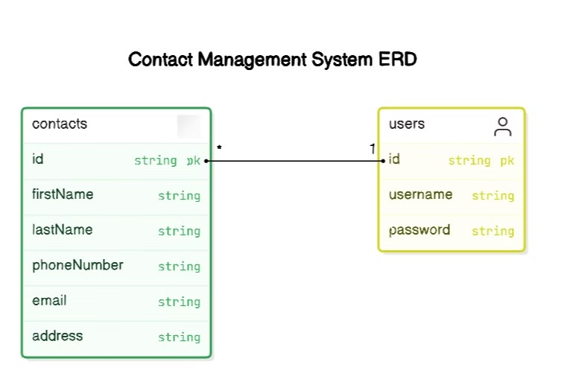
Technical Foundation
1
Java: The Programming Backbone
2
MySQL: The Data Guardian
Java powers both the front-end and back-end functionalities, ensuring cross-platform compatibility and robust performance.
MySQL serves as the underlying database management system, securely storing all contact details.
3
XAMPP: Seamless Connectivity
4
Java Swing: User-Friendly Interface
XAMPP facilitates seamless communication between the Java application and MySQL, ensuring smooth data flow and reliable interaction.
Swing provides a rich graphical interface for users to interact with the system seamlessly.

Slide 4

Core Functionality
Contact Entry
Record Management
Input essential contact details, including name, phone number, email address, and additional information.
Add, update, or delete contact records as needed. The system validates input fields to ensure data accuracy.
Search & Filter Contacts
View Contacts
Efficiently search for contacts by name, phone number, email address, or custom categories.
Display a structured list of contacts with their relevant information, providing easy navigation and access.

Slide 5
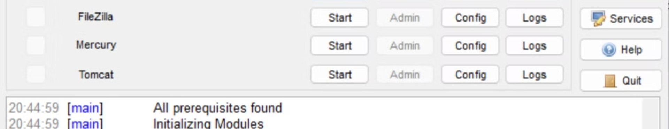



Development Process & Tools
Notepad
CMD
XAMPP
A simple text editor used for writing and editing the Java source code.
Used for compiling and running the Java programs during development and testing.
Provides a local server environment for hosting and managing the MySQL database.

Slide 6

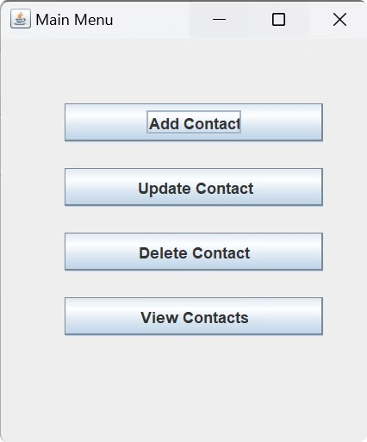
Key Benefits
1
Automate Contact Management
Streamlines the storage, update, retrieval, and deletion of contact information efficiently and accurately.
2
Simplified Data Entry & Retrieval
Users can easily input and access contact details through a user-friendly interface.
3
Secure Database Integration
Contact information is stored securely in a MySQL database, ensuring data integrity and scalability.
4
Enhanced Organization & Accessibility
Contacts are presented in a well-structured, searchable, and sortable format for easy access.

Slide 7
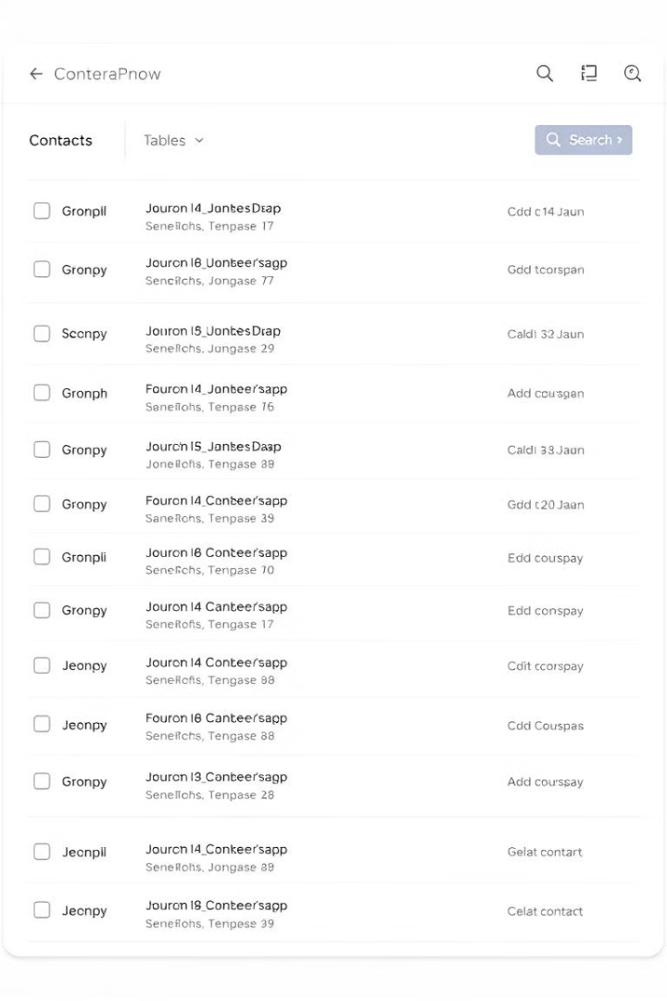
System Implementation & Results
25
Contacts Stored
The system successfully stores and manages a diverse range of contact information.
100%
Accuracy & Efficiency
Data validation ensures accurate entries, and the system retrieves information efficiently.
1
User Satisfaction
The system offers a smooth and intuitive experience, enhancing user satisfaction.

Slide 8
Next Steps & Future Enhancements
Password Security
1
Implement password hashing to enhance security during user authentication.
Role-Based Permissions
2
Add specific user roles (e.g., regular user, admin) to control access to sensitive features.
Contact Grouping
3
Introduce functionality to categorize contacts into groups (e.g., family, work) for better organization.
Export Functionality
4
Add an option for users to export their contacts to external formats for offline use or backup.

